Slide 1
The Divided Kingdom (Part 1)
“Till There Was No Remedy”
(2 Chronicles 36:16)

Slide 2
17 Periods of Bible History
United kingdom
Divided kingdom
Judah alone
Captivity
Return from captivity
Years of silence
Life of Christ
Early church
Letters to Christians
Before the flood
Flood
Scattering of the people
Patriarchs
Exodus
Wandering in wilderness
Invasion & conquest
Judges

Slide 3
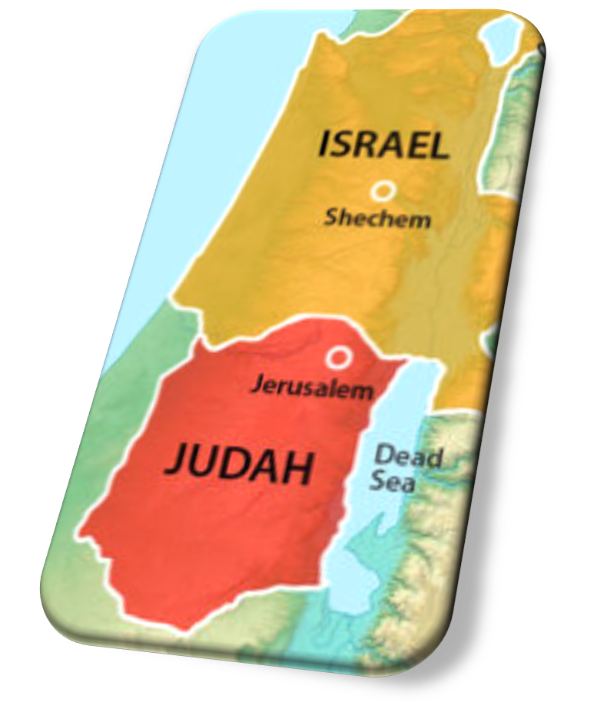
Divided Kingdom: Lesson 19
The Assyrian Empire
Hazael Cuts Israel Short
Jehoiada Enthrones Joash
Athaliah Is Executed
2 Kings 10:31-33
2 Kings 11:4-16
2 Chronicles 23:1-15

Slide 4
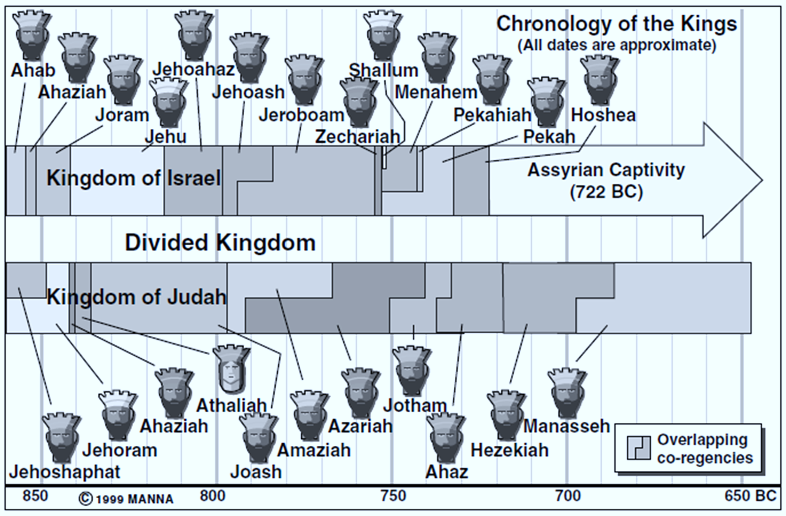

Slide 5
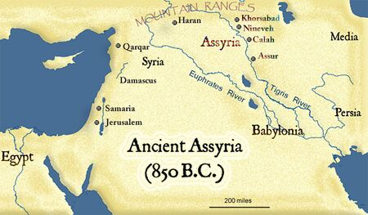
The Assyrian Empire
Capital = Nineveh
NE of Israel
Developed into a mighty empire
God used as a judgment tool
Egypt was Assyria’s rival
Jehu interacted with King Shalmaneser III of Assyria.

Slide 6
The Assyrian Empire
Our curriculum pauses the narrative to consider some history of the developing nation of Assyria during this time.
Assyria had been slowly growing NE of Israel. It would become a key actor on the world stage and in the histories of both Israel and Judah.
Other ancient kingdoms that interacted with Israel/Judah were small (Syria, Moab, Edom, Ammon, Philistia, Phoenicia).
Assyria’s geographical expanse had ebbed and flowed, but about the time Solomon’s kingdom divided, it began to expand.

Slide 7
The Assyrian Empire
A people known for their cruelty, harshness.
Shalmaneser III became the Assyrian king (circa 859 BC).
Ahab defeated Ben-hadad of Syria in battle twice.
Ahab died when he fought Ben-hadad a third time – this time with the help of Jehoshaphat (1 Kings 22).
A few years before Ahab’s death, Shalmaneser invaded Canaan.
At that time, Ahab (Israel) & Ben-hadad (Syria) put aside their differences and formed a coalition against the Assyrian invasion at the battle of Qarqar (853 BC).
Shalmaneser defeated the coalition against him, but not decisively enough to expand into Canaan.

Slide 8
The Assyrian Empire
Hazael was anointed king of Syria by Elisha in 842 BC (2 Kings 8).
Shalmaneser attacks Syria (circa 841 BC).
This was around the time Athaliah usurped Judah’s throne.
Hazael had to face Assyria alone. Jehu (Israel) did not come to his aid.
Shalmaneser reached Damascus (the capital of Syria) but could not conquer the city.

Slide 9
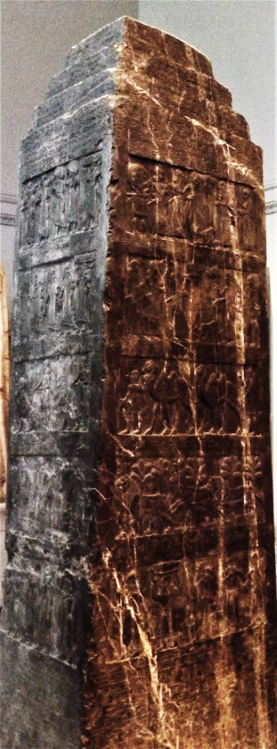
The Assyrian Empire
Shalmaneser attacked Syria (approx. 841 B.C.)
Instead of joining Hazael to fight Shalmaneser, Jehu submitted to the Assyrian king and paid tribute.
Shalmaneser eventually erected the Black Obelisk, on which were various panels showing reliefs of kings submitting to him.
One such panel reads, “The tribute of Jehu, son of Omri”
Notes:
* 1 Kings 20

Slide 10
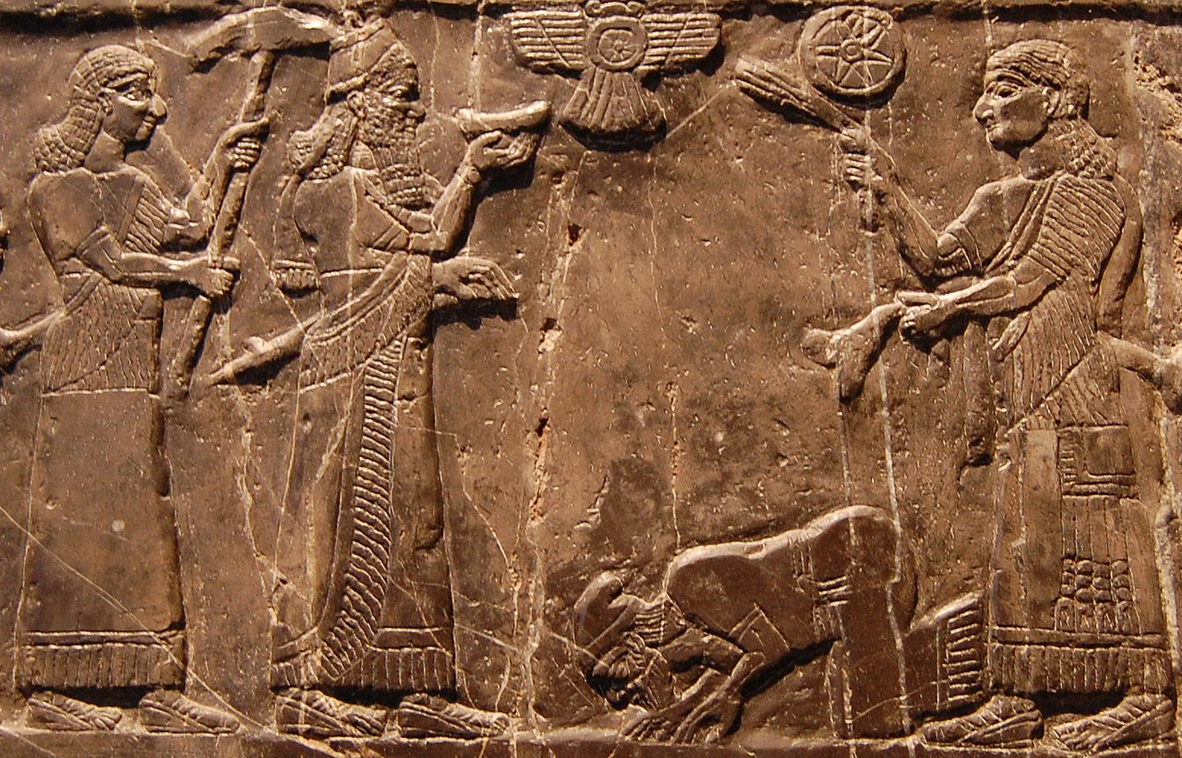
Jehu pays Tribute to Shalmaneser

Slide 11
Jehoiada Enthrones Joash in Judah (2 Kings 11:4-12; 2 Chronicles 23:1-11)
The time had come to bring Judah’s rightful king out of hiding.
Joash was only 7 years old; it would not be easy.
Athaliah had already shown her ruthless character (2 Kings 11:1).
Jehoiada had to “strengthen himself” (2 Chron. 23:1).
Notes:
1 Kings 21:21 'Behold, I will bring calamity on you. I will take away your posterity, and will cut off from Ahab every male in Israel, both bond and free.

Slide 12
Jehoiada Enthrones Joash in Judah (2 Kings 11:4-12; 2 Chronicles 23:1-11)
Jehoiada’s actions to protect and anoint Joash (2 Chronicles 23:1-10).
He establishes an armed protective detail around him (23:1).
He gathers the nation’s leadership to solicit their support (23:2).
He commits everyone to what God had spoken to David regarding Judah’s throne (23:3, cf. 2 Sam 7).
He divides the guards into companies to keep constant watch (23:4-5).
He maintains the Law’s restrictions regarding the holy Temple (23:6; cf. Num 18:22).
He surrounds young Joash with protection (23:7-10).
Notes:
Numbers 18:22 Hereafter the children of Israel shall not come near the tabernacle of meeting, lest they bear sin and die.

Slide 13
Jehoiada Enthrones Joash in Judah (2 Kings 11:4-12; 2 Chronicles 23:1-11)
Jehoiada places Joash on David’s throne (23:11).
Joash is given the crown.
He is given a copy of “the testimony” (cp. Exodus 25:16; Deut. 17:18-19).
This was a symbol that God’s law through Moses would govern his reign.
Jehoiada and his sons openly proclaim Joash as king, crying “Long live the king!”
Notes:
The Law is referred to as “the Testimony” in Exodus 25:16 And you shall put into the ark the Testimony which I will give you.
Deuteronomy 17:18-19 "Also it shall be, when he sits on the throne of his kingdom, that he shall write for himself a copy of this law in a book, from the one before the priests, the Levites. 19 And it shall be with him, and he shall read it all the days of his life, that he may learn to fear the LORD his God and be careful to observe all the words of this law and these statutes,

Slide 14
Athaliah is Executed (2 Kings 11:13-16; 2 Chronicles 23:12-15)
Athaliah hears the noise of Joash’s coronation (23:12-13)
She enters the temple and sees her young grandson Joash crowned and the military leaders celebrating with all the people.
Athaliah tears her clothes and cries, “Treason!”
Jehoiada orders her execution (23:14-15)
He instructs the captains to remove her from the temple so as not to defile the Lord’s house.
Her followers were also to be slain.
She is taken to the Horse Gate by the king’s house and killed there.

Slide 15
Lesson for Today
As in the case of Jehoiada anointing Joash, it requires both wisdom and courage to do God’s will in difficult times.
We must stand courageously (1 Corinthians 16:13).
We must have moral and spiritual resolve, an understanding of the risks involved, a wise plan of action, and complete trust in God (Esther 4:9-16; Acts 4:19-20; 5:28-29).
Notes:
1 Corinthians 16:13 Watch, stand fast in the faith, be brave, be strong.

